Slide 1
Preparing your Pitch
Dat Hack ‘19
TEAM MEDICARE

Slide 2

How to Get Started
What is the problem
Lack of good child delivery care
Inadequate maternity care
Lack of consultation
Lack of knowledge on first aid user guild

Slide 3
Introduce your Solution
1. Getting good access to the medical personnel
2. To make communication between Doctor and patient effective
3. Make child delivery (maternity) easy
4. Making consultation easy and fast
5. Making other have knowledge about first aid.

Slide 4
How it Works
PATIENT FIRST TIME | PATIENT | NURSE FIRST TIME | NURSE | DOCTOR FIRST TIME | DOCTOR
SIGN UP | SIGN IN | SIGN UP | SIGN IN | SIGN UP | SIGN IN
CREATE ACCOUNT | HOME | CREATE ACCOUNT | HOME | CREATE ACCOUNT | HOME
COMM. WITH DOCTOR | COMM. WITH DOCTOR | COMM. WITH PATIENT | COMM. WITH PATIENT | COMM. WITH PATIENT | COMM. WITH PATIENT

Slide 5
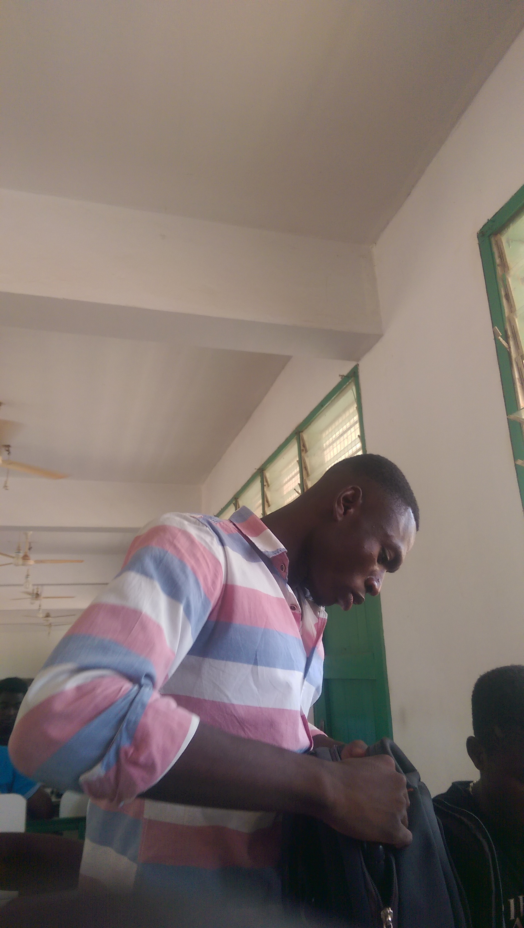
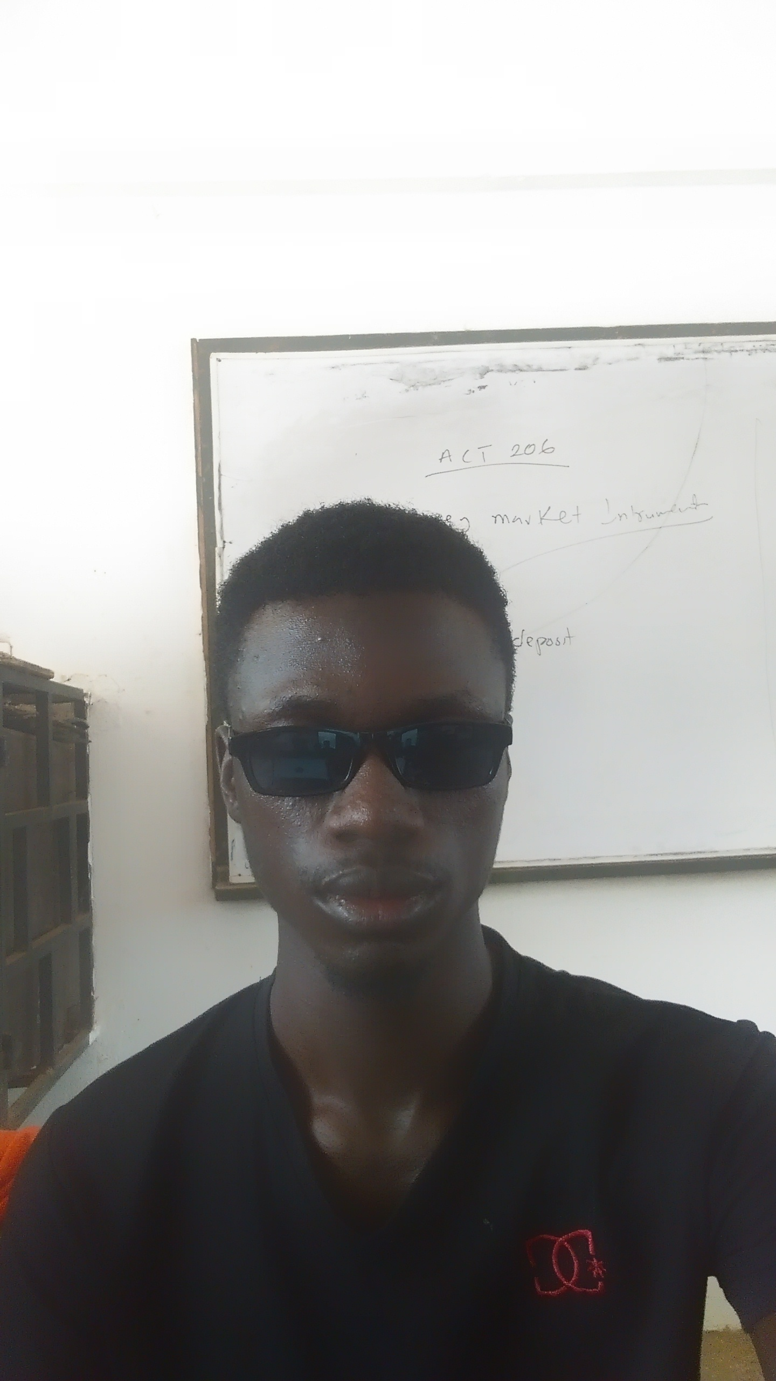
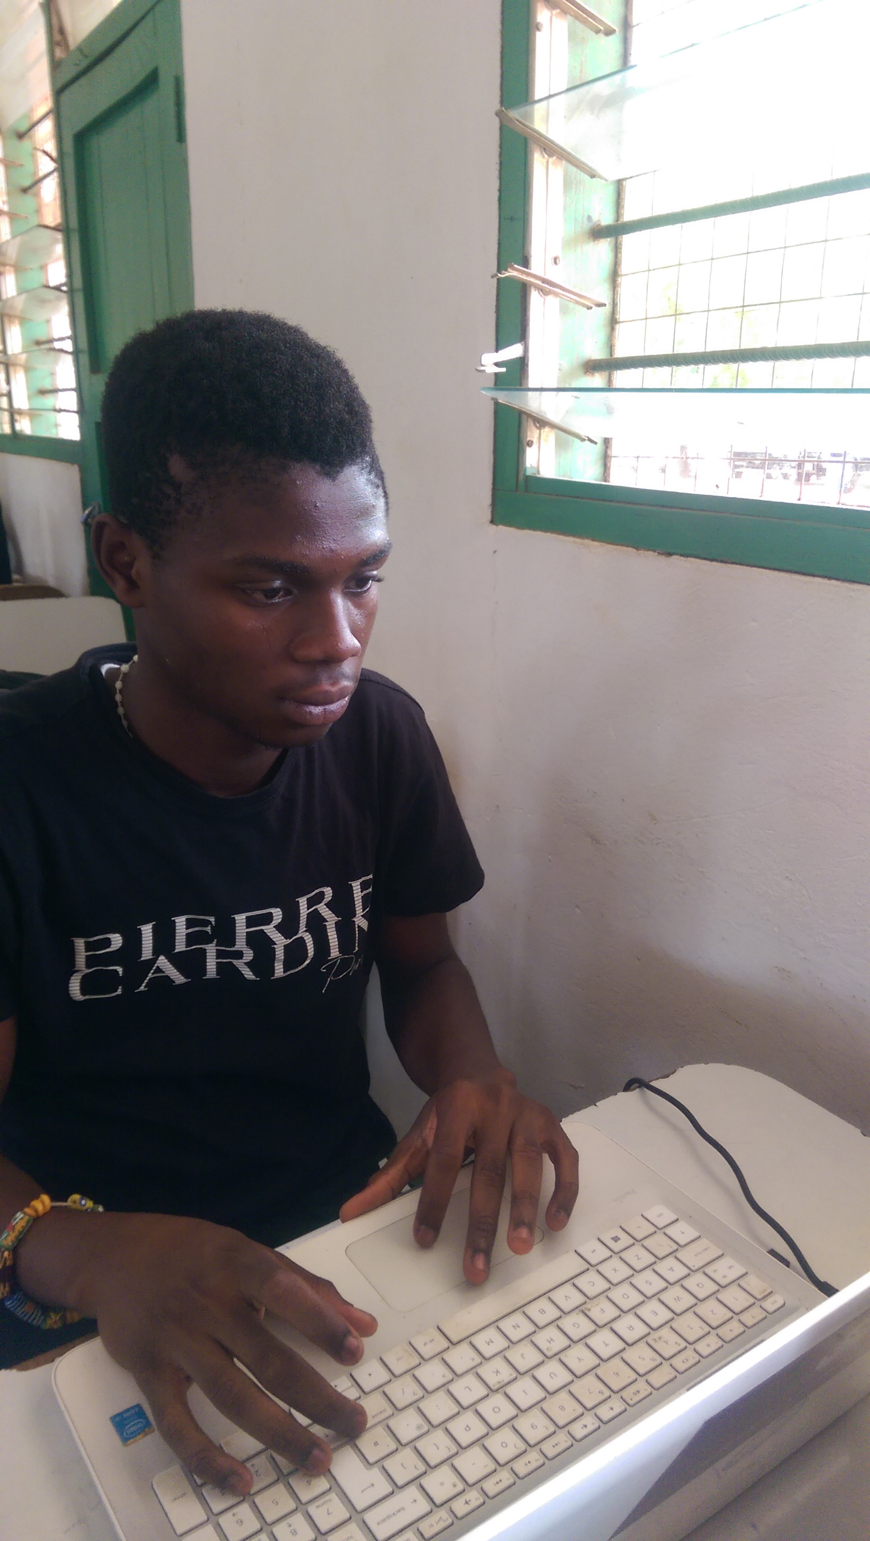
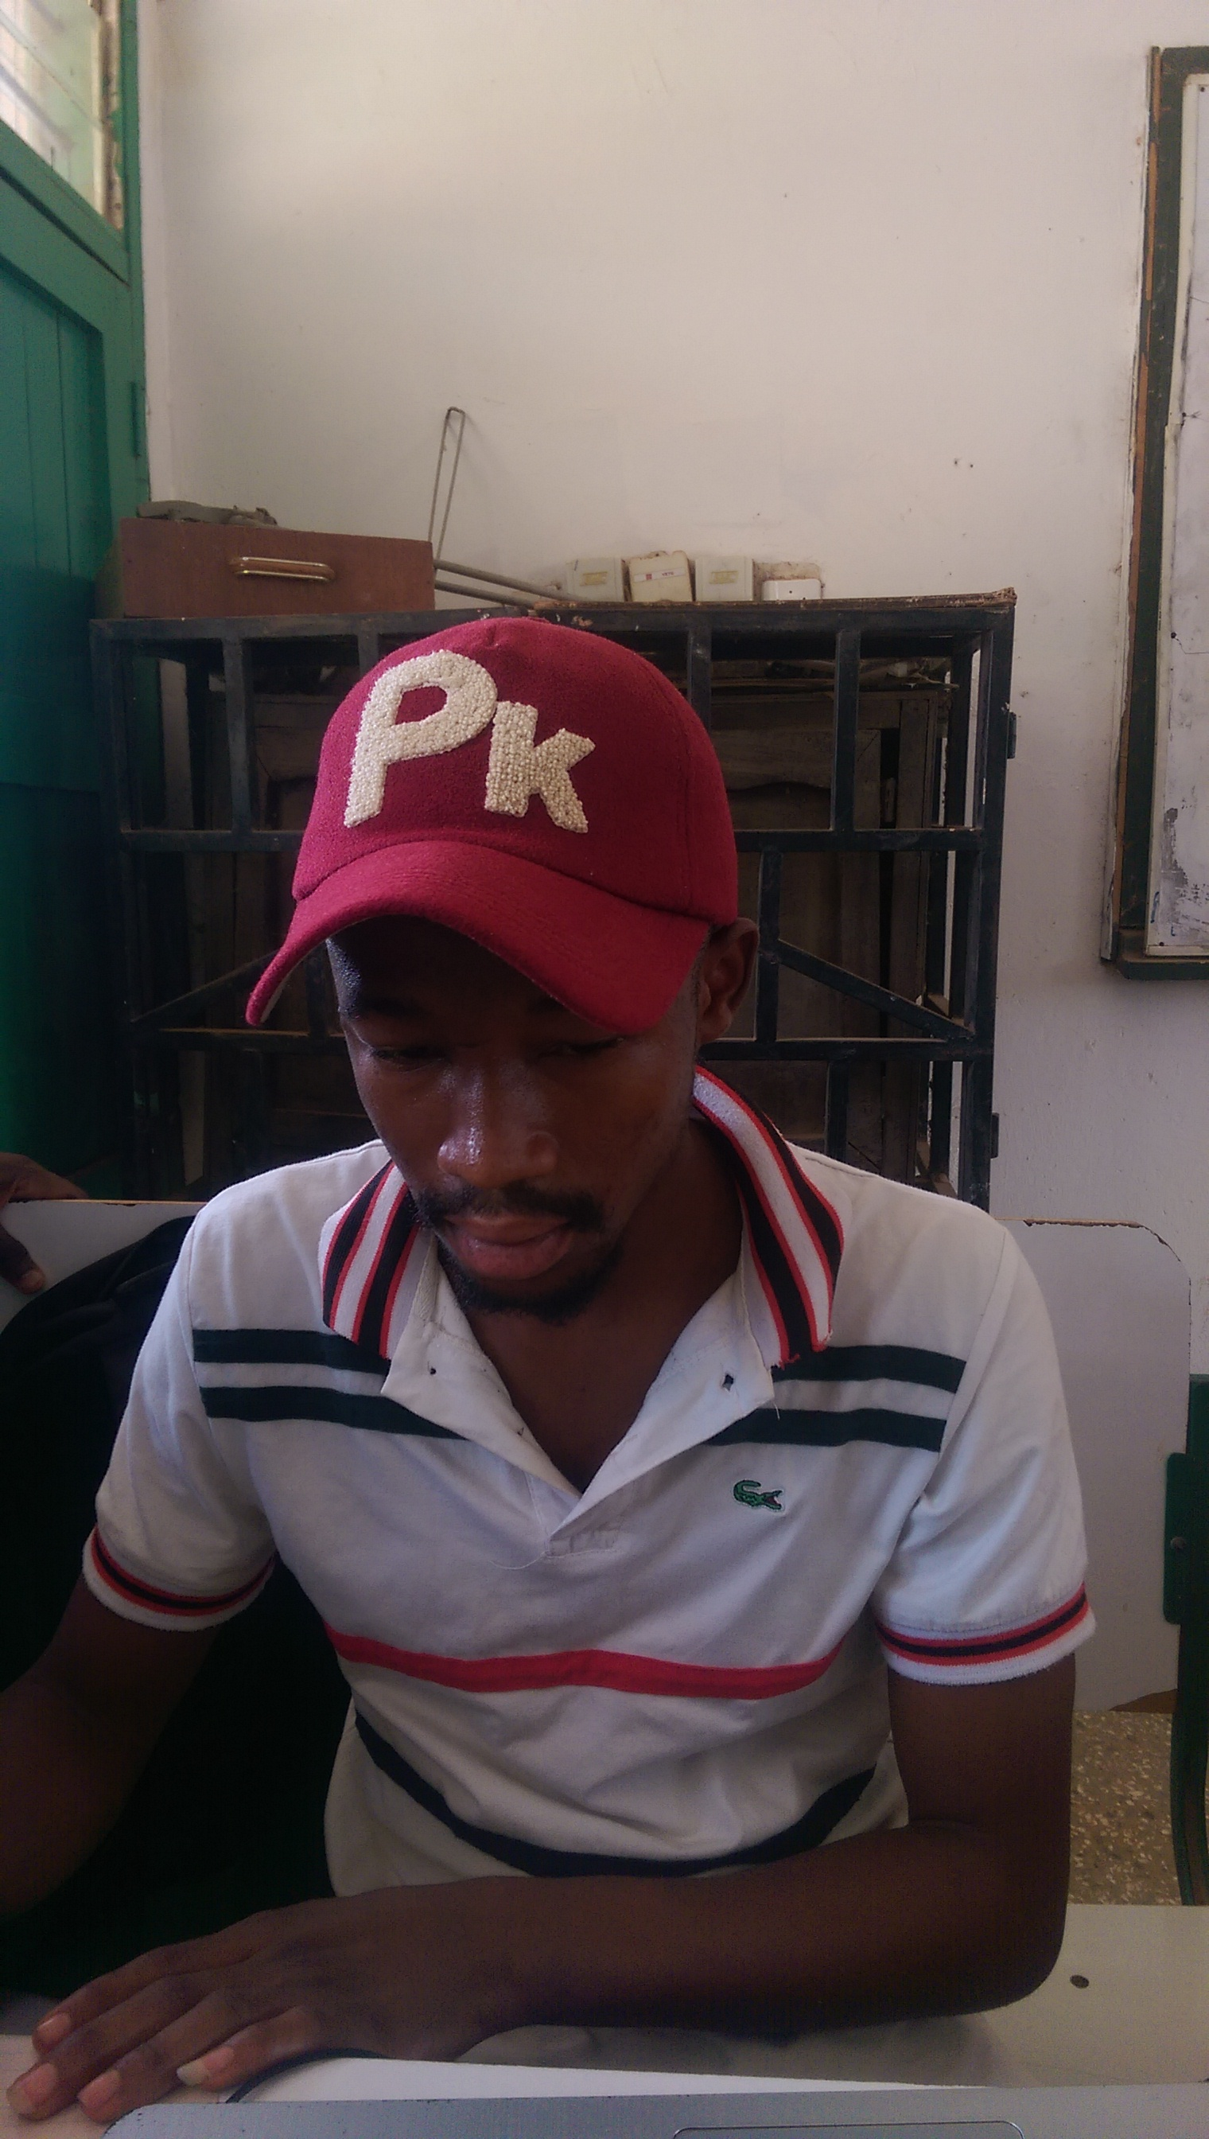
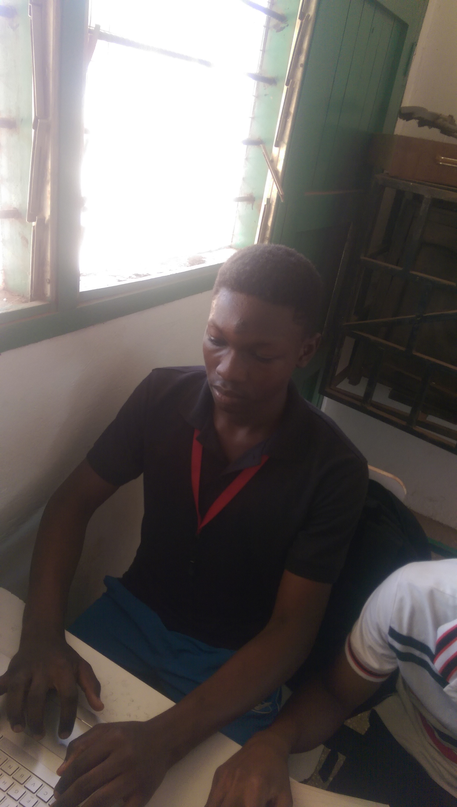
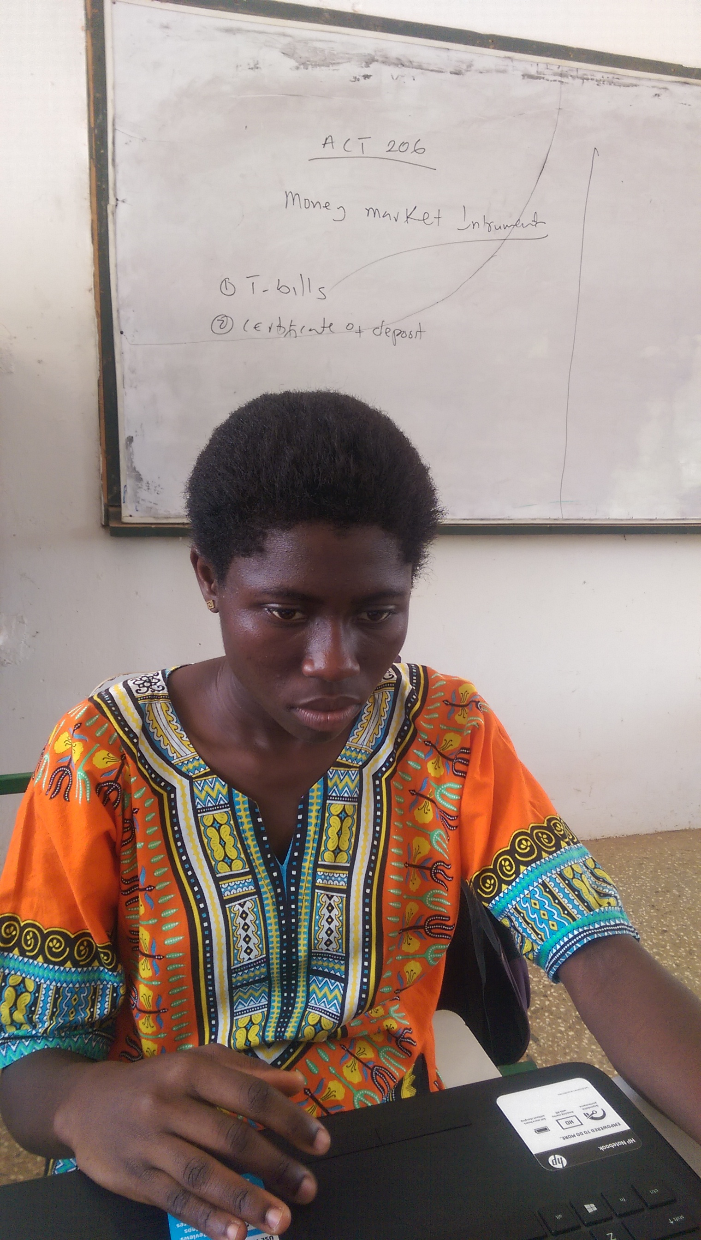
TEAM
MAX 7
KAFUI
MAWULI
KABIRU
BASSELL
DELA

Slide 6
Live Demo
Enjoy the demo cause it’s show time !!!

Slide 7
Thank you

